Slide 1

Fake News Detection Using Machine Learning &
Deep Learning Techniques
By SAI KRISHNA VENI
(MCA Student, CUSAT)
Guided By Dr. Balasubramanian P
(Assistant Professor
Indian Institute of Information Technology Kottayam)

Slide 2
Outline:
Introduction
FND techniques
FND Stages
Dataset Details
Various ML and DL Models
Results and Comparison
Literature Survey

Slide 3

Introduction:
-> Fake news is false or misleading information presented as it were real news.
-> False news is like an unproven story that spreads quickly that spreads quickly because people belive it’s true.
-> It can spread through social media, websites or even traditional news outlets.
-> It may be created to make money, to influence opinions, or to cause harm.
-> It is critical of the news we read and to check if it comes from a reliable source.

Slide 4
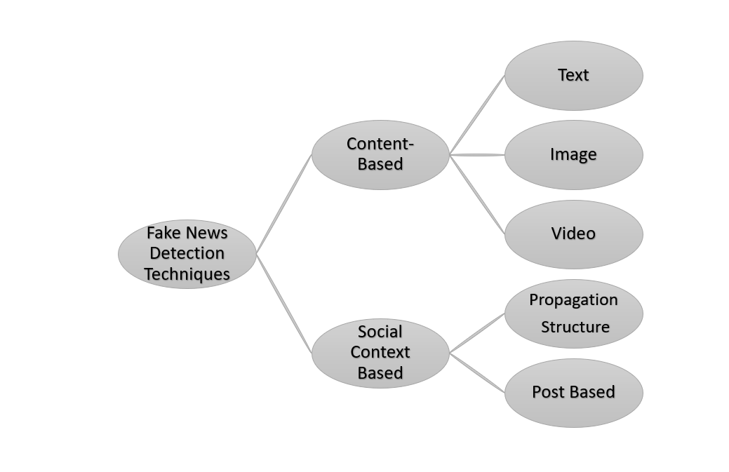

Slide 5
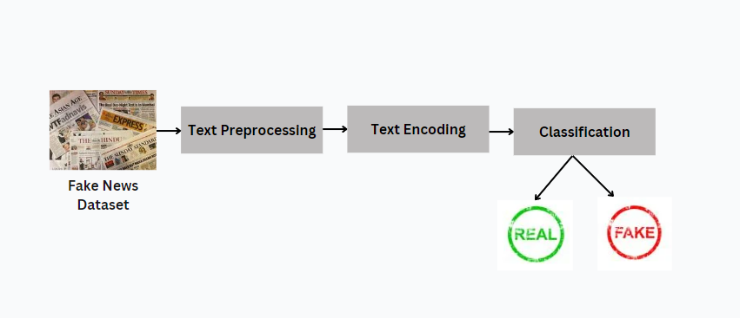
Fake News Detection Stages:

Slide 6
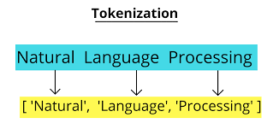
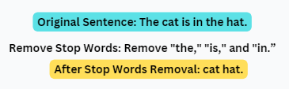
Text Preprocessing:
Text preprocessing is a method to clean the text data and make it ready to feed data to the model. Text data contains noise in various forms like emotions, punctuation, text in a different case.
Tokenization:
Text preprocessing is a method to clean the text data and make it ready to feed data to the model. Text data contains noise in various forms like emotions, punctuation, text in a different case.
Stop Word Removal:
Stopwords removal in natural language processing (NLP) is the process of eliminating words that occur frequently in a language but carry little or no meaning.

Slide 7
3. Text Encoding
Text encoding is a process to convert meaningful text into number / vector representation so as to preserve the context and relationship between words and sentences, such that a machine can understand the pattern associated in any text and can make out the context of sentences.
BERT Word Embedding:
Tokenization:
Convert the input text into tokens using BERT's tokenizer, adding special tokens like [CLS] and [SEP].
Input Representation:
Create input vectors that combine token embeddings, segment embeddings, and position embeddings.

Slide 8
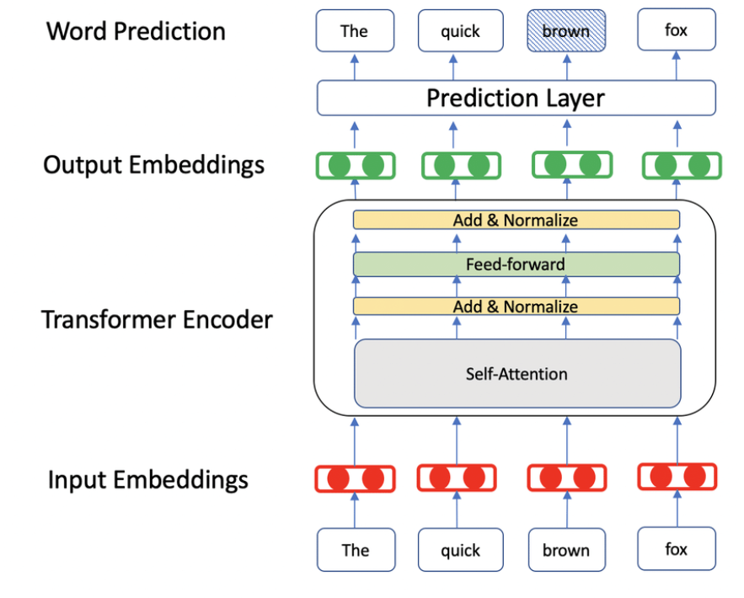


Transformer Layers:
Pass the input vectors through multiple Transformer layers to capture contextual information.
BERT has 12 encoders in which each are divided into 2 layers – Multihead Attention Layer and Artificial Neural Network.
BERT Self Attention – Attention matrix is calculated using the following equation.
Multi head attention matrix is calculated using
Output Embeddings:
Extract the final embeddings from the last Transformer layer, representing the contextualized word embeddings.

Slide 9
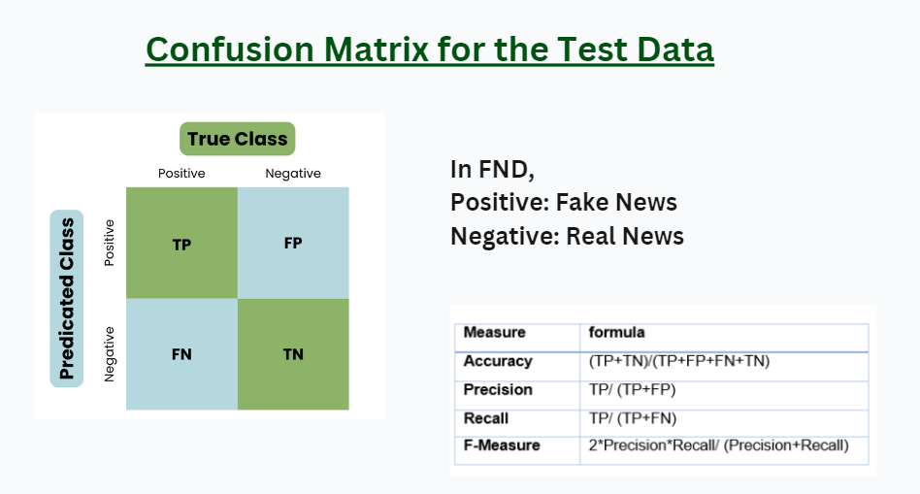

Slide 10
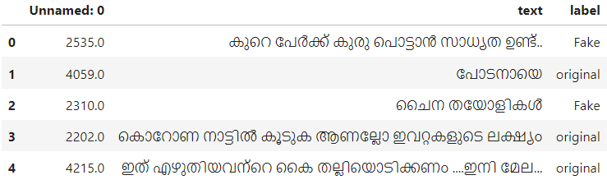
DataSet Details:
Total number of data: 4952
Original: 2462
Fake: 2490
Total number of test data: 3673
Original: 1889
Fake: 1784
Total number of train data: 3673
Original: 495
Fake: 424

Slide 11
Machine learning FND techniques
Linear Regression
K-Nearest Neighborhood
Naive Bayes
Decision Tree
Support Vector Machine
Random Forest

Slide 12
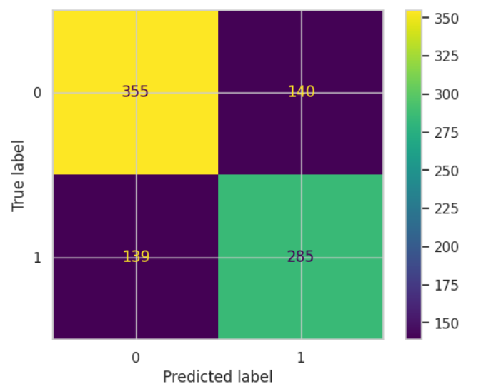
Model 1: Logistic Regression
Logistic regression is used for binary classification where we use sigmoid function, that takes input as independent variables and produces a probability value between 0 and 1.
Results:
Accuracy - 0.6964
Precision - 0.6706
Recall - 0.6722
F1 - 0.6714

Slide 13
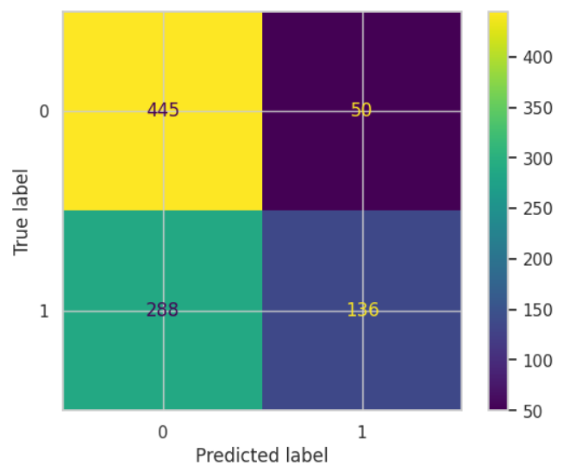
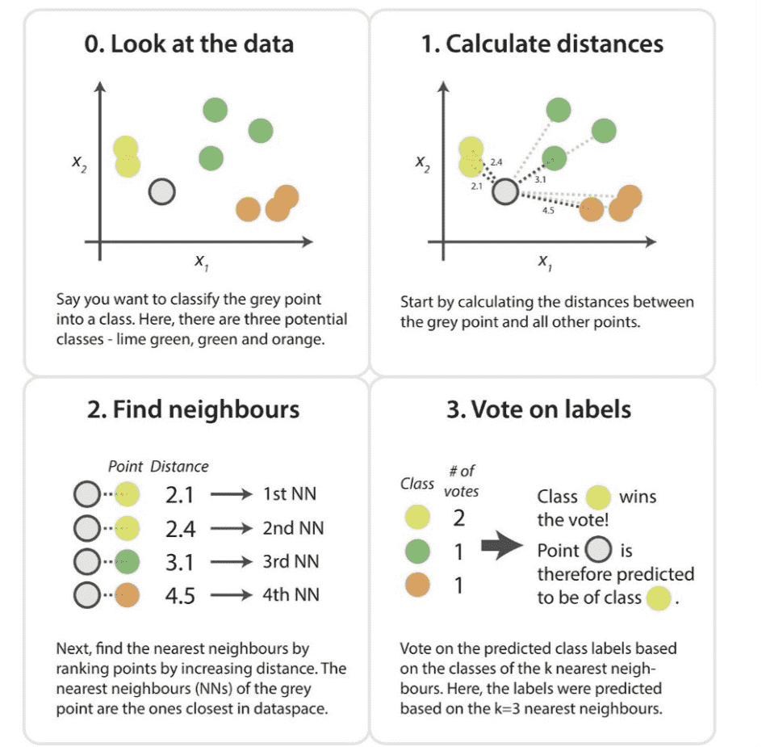
Model 2: K- Nearest Neighbor
Results:
Accuracy - 0.6322
Precision - 0.7312
Recall - 0.3208
F1 - 0.4459

Slide 14
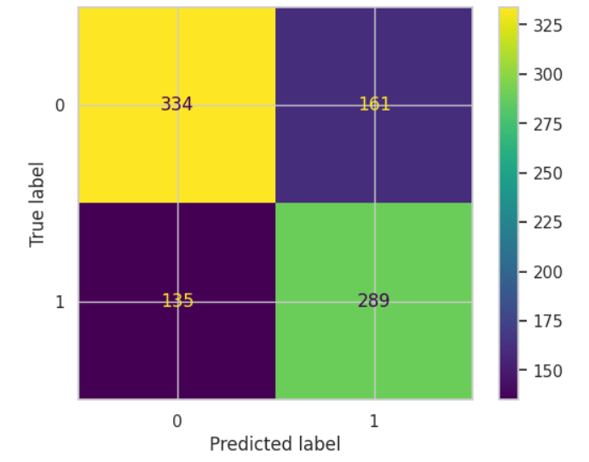
Model 3: Naive Bayes
Naive Bayes is a probabilistic classification algorithm based on Bayes' theorem with an assumption of independence among features.
P (Class |Data) = P (Class ∩ Data) / P(Data)
Results:
Accuracy - 0.6779
Precision - 0.6422
Recall - 0.6816
F1 - 0.6613

Slide 15
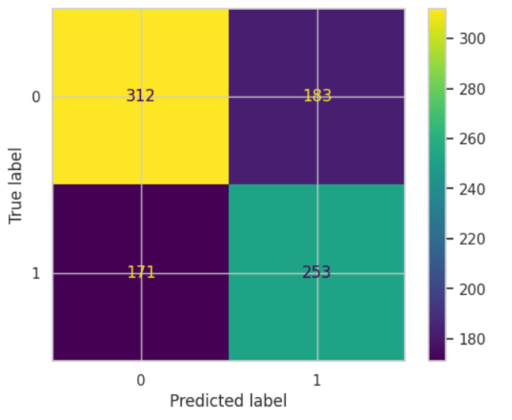
Model 4: Decision Tree
It is a tree-structured classifier, where internal nodes represent the features of a dataset, branches represent the decision rules and each leaf node represents the outcome.
A decision tree simply asks a question, and based on the answer (Yes/No), it further split the tree into subtrees.
Results:
Accuracy - 0.6148
Precision - 0.5803
Recall - 0.5967
F1 - 0.5884

Slide 16
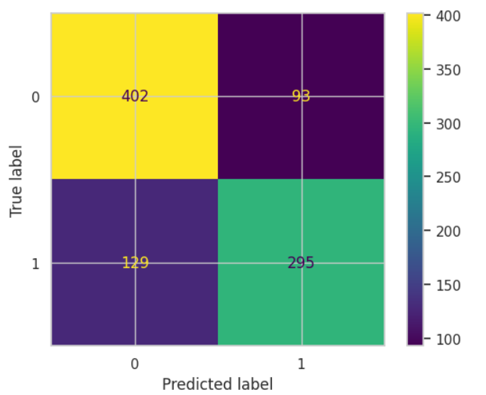
Model 5: Support Vector Machine
The objective of the support vector machine algorithm is to find a hyperplane in an N-dimensional space(N — the number of features) that distinctly classifies the data points.
Results:
Accuracy - 0.7584
Precision - 0.7603
Recall - 0.6958
F1 - 0.7266

Slide 17
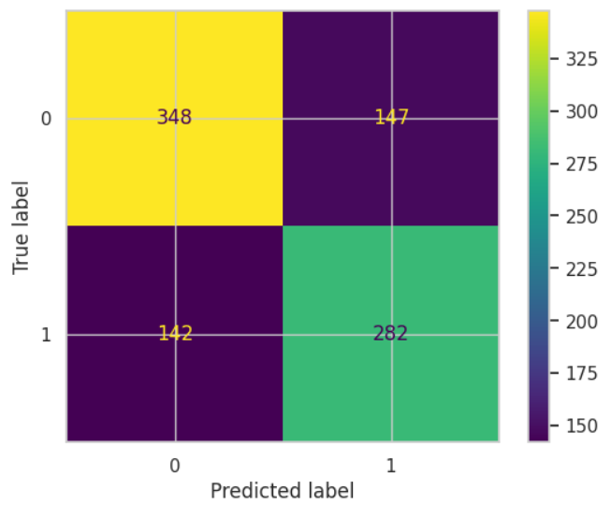
Model 6: Random Forest
Ensemble Learning:
Ensemble simply means combining multiple models. Thus a collection of models is used to make predictions rather than an individual model.
Ensemble uses two types of methods:
Bagging
It creates a different training subset from sample training data with replacement & the final output is based on majority voting. For example, Random Forest.
Boosting
It combines weak learners into strong learners by creating sequential models such that the final model has the highest accuracy. For example, Gradient BOOST, ADA BOOST, XG BOOST.
Results:
Accuracy - 0.6855
Precision - 0.6573
Recall - 0.6651
F1 - 0.6612

Slide 18
Deep Learning FND techniques
Feed Forward Neural Network
Long Short-Term (LSTM)
Bi-LSTM
Convolutional Neural Network
Recurrent Neural Network

Slide 19
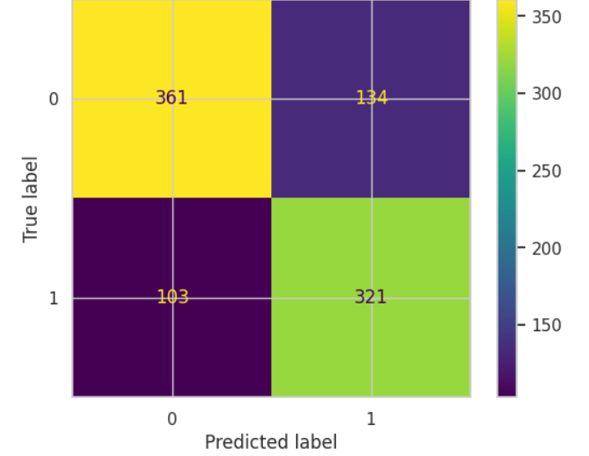
Model 7: Feed Forward Neural Network
Input Layer: 128 units
Hidden Layer: 64 units with ReLU activation
Output Layer: 1 unit with sigmoid activation
Loss Function: Binary Crossentropy (suitable for binary classification)
Optimizer: Adam (commonly used optimizer for training neural networks)
Results:
Accuracy - 0.7421
Precision - 0.7055
Recall - 0.7571
F1 - 0.7304

Slide 20
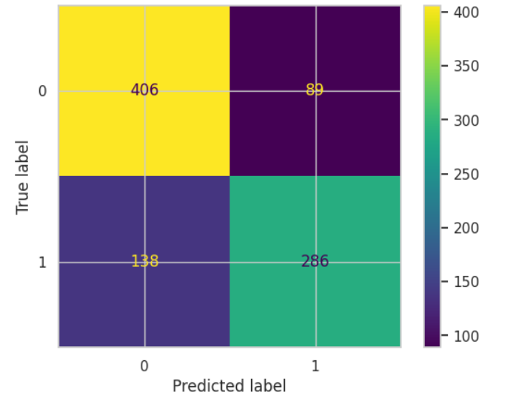
Model 8: Convolution Neural Network
Architecture: Input → Reshape → Conv2D → MaxPool2D → Flatten → Dense(128, ReLU) → Dropout → Dense(1, Sigmoid)
Loss Function: Binary Cross entropy
Optimizer: Adam
Results:
Accuracy - 0.7530
Precision - 0.7627
Recall - 0.6745
F1 - 0.7159

Slide 21

Model 9: Recurrent Neural Network
Architecture: Input → SimpleRNN(128, return_sequences=True) → SimpleRNN(128) → Dense(128, ReLU) → Dropout → Dense(1, Sigmoid)
Loss Function: Binary Crossentropy
Optimizer: Adam
Results:
Accuracy - 0.7084
Precision - 0.7155
Recall - 0.6108
F1 - 0.6590

Slide 22
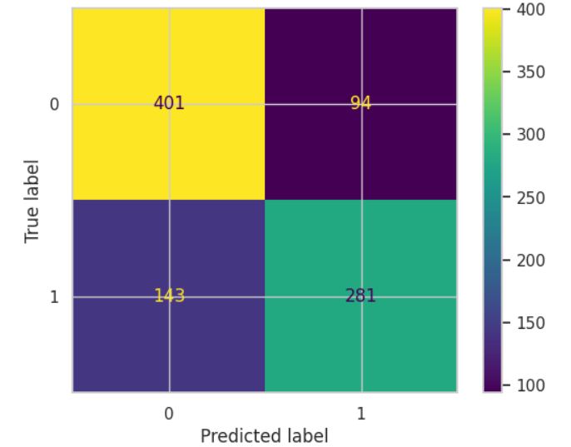
Model 10: Long Term Short Memory
Architecture: 3 LSTM layers → Flatten → Dense(128, ReLU) → Dense(1, Sigmoid)
Loss Function: Binary Crossentropy
Optimizer: Adam
Results:
Accuracy - 0.7421
Precision - 0.7493
Recall - 0.6627
F1 - 0.7034

Slide 23
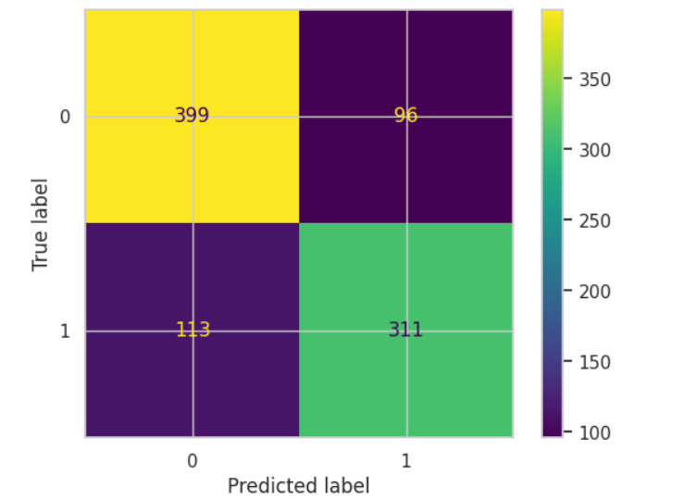
Model 11: Bidirectional-LSTM
Architecture: 3 Bidirectional LSTM layers → Flatten → Dense(128, ReLU) → Dense(1, Sigmoid)
Loss Function: Binary Crossentropy
Optimizer: Adam
Results:
Accuracy - 0.7726
Precision - 0.7641
Recall - 0.7335
F1 - 0.7485

Slide 24
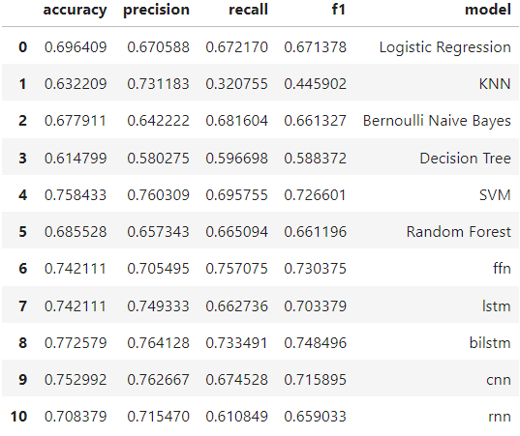

Results:

Slide 25
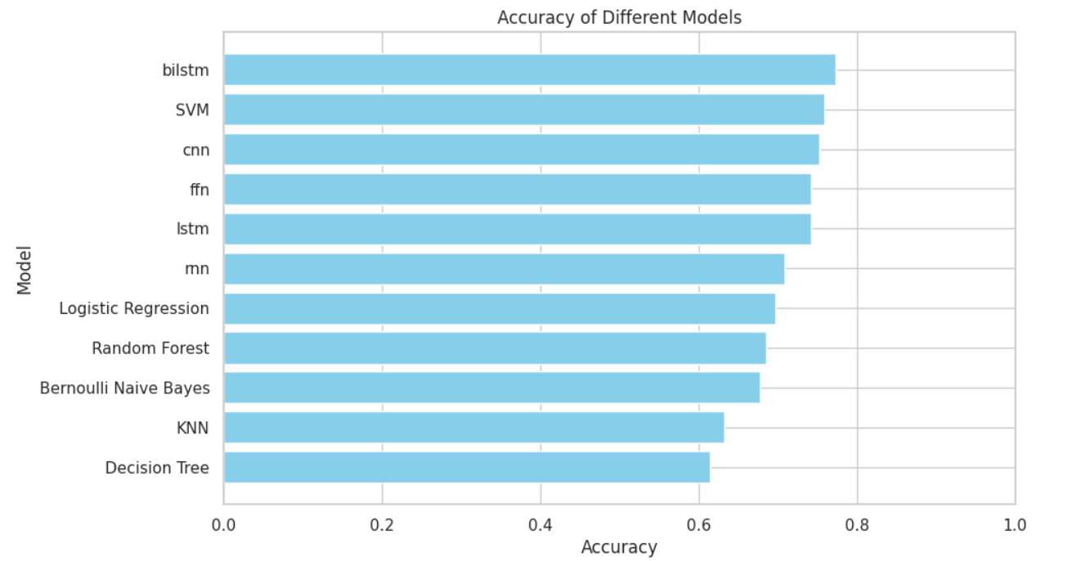

Slide 26
Accuracy:
The highest accuracy is achieved by Bi-LSTM (0.772579), followed closely by CNN (0.752992).
The lowest accuracy is observed for the Decision Tree model (0.614799).
Precision:
The highest precision is achieved by Bi-LSTM (0.764128), followed by CNN (0.762667) and SVM (0.760309).
The lowest precision is observed for the Decision Tree model (0.580275).
Recall:
The highest recall is achieved by Bi-LSTM (0.733491), followed closely by Random Forest (0.665094) and Bernoulli Naive Bayes (0.681604).
The lowest recall is observed for the KNN model (0.320755).
F1 Score:
The highest F1 score is achieved by Bi-LSTM (0.748496), followed by SVM (0.726601) and Feed Forward Neural Network (0.730375).
The lowest F1 score is observed for the KNN model (0.445902).

Slide 27
Overall Performance:
The Bi-LSTM model performs the best overall, achieving the highest scores in most metrics (accuracy, precision, recall, and F1 score).
SVM and CNN also perform well, with SVM showing a strong balance across all metrics.
The KNN model performs the worst, particularly in recall and F1 score, indicating that it struggles with correctly identifying positive instances.

Slide 28
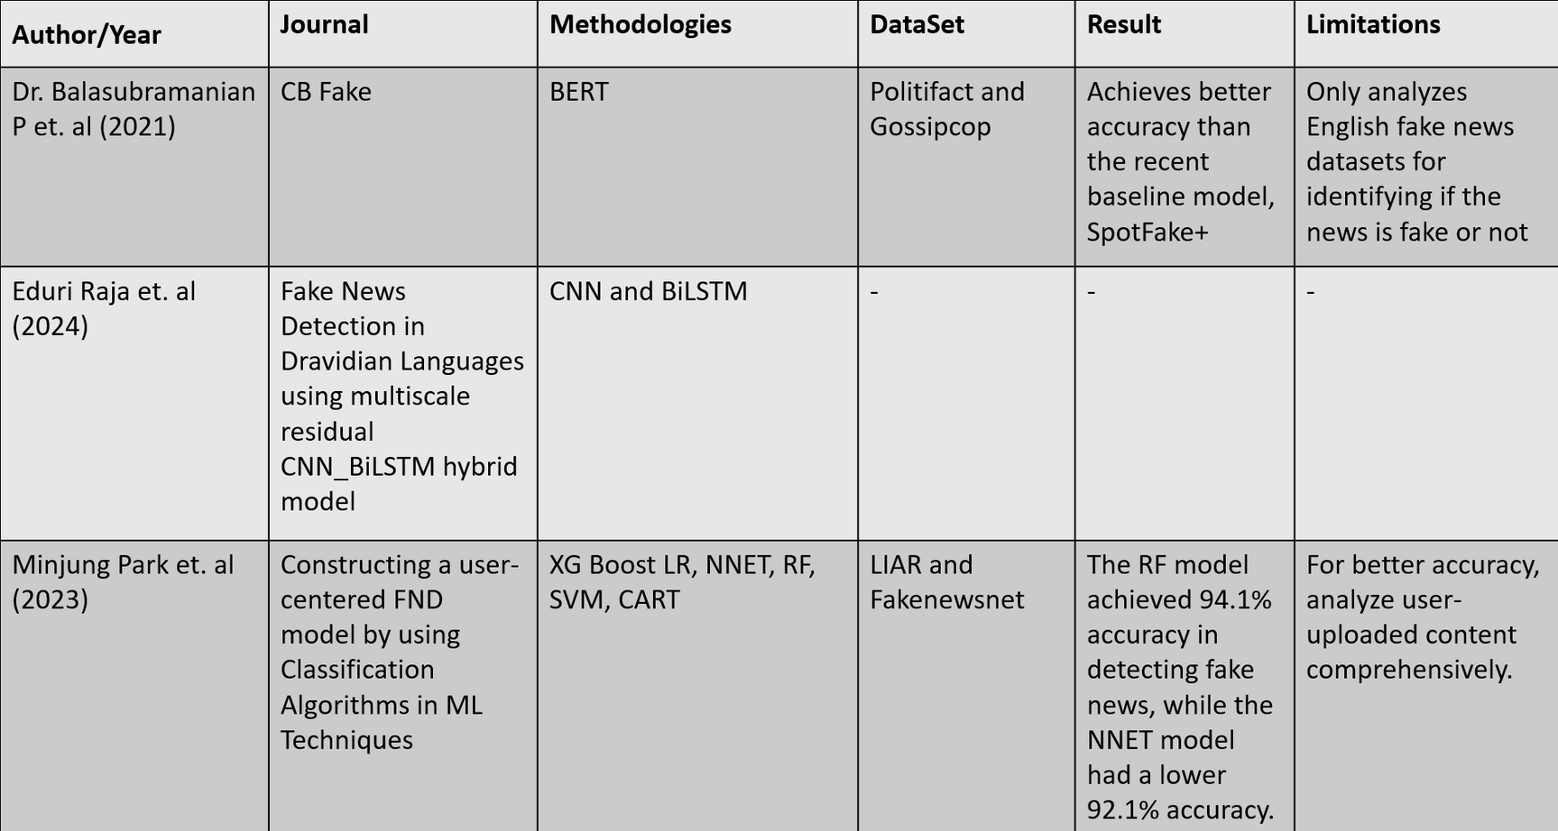
Literature Survey:

Slide 29
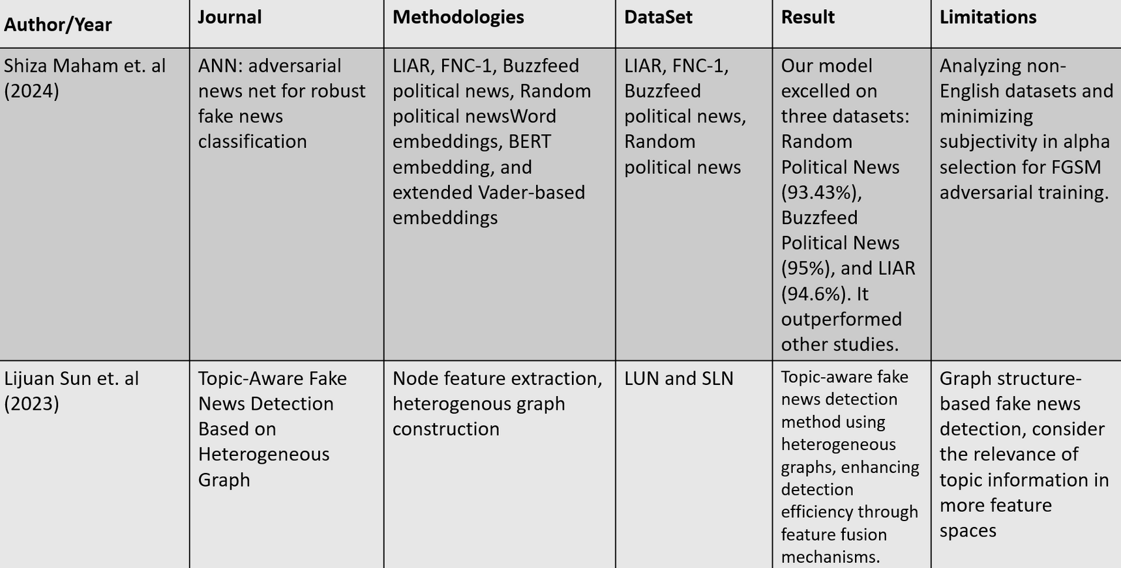

Slide 30
References:
Raja, E., Soni, B., & Borgohain, S. K. (2023). Fake news detection in Dravidian languages using transfer learning with adaptive finetuning. Engineering Applications of Artificial Intelligence, 126, 106877.
Zhang, X., & Ghorbani, A. A. (2020). An overview of online fake news: Characterization, detection, and discussion. Information Processing & Management, 57(2), 102025.
Palani, B., Elango, S., & Viswanathan K, V. (2022). CB-Fake: A multimodal deep learning framework for automatic fake news detection using capsule neural network and BERT. Multimedia Tools and Applications, 81(4), 5587-5620.
https://towardsdatascience.com/all-you-need-to-know-about-gradient-boosting algorithm-part-1-regression-2520a34a502
https://scikit-learn.org/stable/modules/svm.html
https://medium.com/@hansenidden18/extracting-word-embedding-sentence embedding-from-bert-for-twitter-sentiment-analysis-d728696df8e0

Slide 31
Thankyou !

